Slide 1
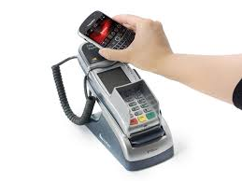
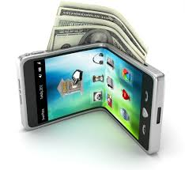
Mobile Wallet

Slide 2
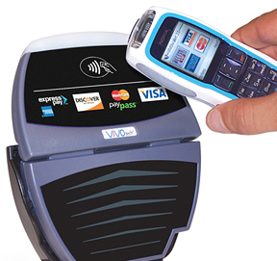
Introduction
What is Mobile Wallet?
What is NFC?

Slide 3
Introduction
Motivation
Aims and Objectives

Slide 4


Identification and challenging issues
Security
Development

Slide 5


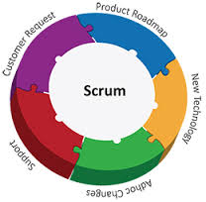
Project Plan
Technology review
PhoneGap
PHP
Development Methodology
Scrum

Slide 6
Project Plan
Deliverables
Identity | Operation | Time Duration
Proposal | Mobile Wallet: Proposal | 25 August 2014 – 30 August 2014
1st progress | - Card Register system - Account system | 1 September 2014 – 30 September 2014
2nd progress | - Security system - NFC Censor system | 1 October 2014 – 30 October 2014
3nd progress | - Profile & Pasteboard system - User Interfaces | 1 November 2014 – 30 October 2014

Slide 7
Project Management
purpose
Team Roles
No. | Participants | Roles
1 | Mr. Manuchet Manoi | Software Design
2 | Mr. Passakorn Buadee | Developer
3 | Mr.Witsaras Suninhong | Developer
4 | Mr. Saknarong Noipaksa | Tester
5 | Mr. Supawit Kamjina | Project Manager
6 | Mrs. Yanhua Li | Requirement Analyst
Constrains

Slide 8
Project Management
version control
GitHub
“[Project Name]-[Document Name] _ [Version]. [File Type]”

Slide 9
Project Impact
 | Description(level[High/Medium/Low])
Advantage | Consumer: NFC mobile wallet can card one more, can achieve unity machine card.[H] NFC mobile wallet make consumers pay more convenient, save a lot of time cost.[H] Mobile phone no electricity, can also be NFC payments[M] Retailer: NFC mobile wallet can reduce business costs and the required personnel.[H] NFC technology will be conducive to marketing, pricing, sales , can better evaluate shopping behavior.[M]
Disadvantage | Mobile phones can only be read against the chip card electronic wallet information limited, and cannot transfer operation.[M] NFC mobile wallet also bring larger safe hidden trouble, easy cause consumer bank card information.[H]

Slide 10
Risk Management
Risk statement | Risk solution
Demand is not clear | For more communication with customer.
The lack of visibility | Agile Software Development.
Technical compatibility risk | Technical compatibility test in advance.
Usability problems | Early detection and timely correction.

Slide 11

Question&Answer

